Slide 1
Hashing
…or How your passwords are actually stored

Slide 2
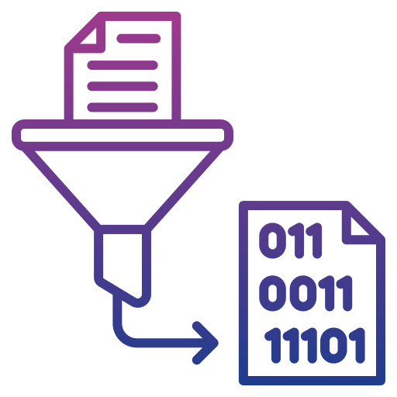
What is a hash function?
A hash function takes an input and does some maths and gives a nearly unique output.
It is one way, i.e. you can’t run it in reverse
If the output is an 8-digit hexadecimal string (like 703a4f6c) it gives 16*16*16*16*16*16*16*16 (4’294’967’296) possible outputs
So eventually the output from 2 different inputs would be the same

Slide 3
Some hash functions…
MD5
SHA-1
SHA-2
NTLM
LANMAN
SHA256
SHA512
At time of writing, you should probably use bcrypt
  Hashing functions go out of date. Why?

Slide 4
Collisions
When 2 inputs have same output from hash functions.
Bad
  Mitigation?
    Linear probing or chaining can lead to linear search situation
Happens less in SHA512 than SHA256
  No surprises there

Slide 5
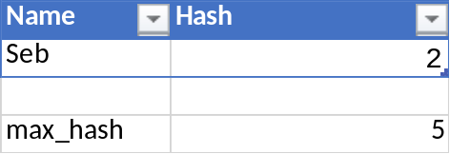
Hash… how?
Look it up!
It’s maths that’s hard to reverse
It may use powers and big prime numbers and stuff
We can write simplified ones using modulo

Slide 6
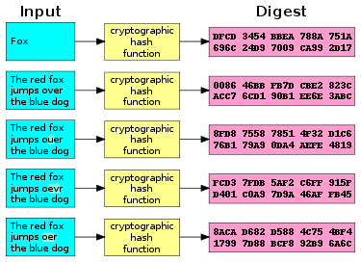
Crypto Hash function
Note how one char changing produces a totally different output!
This is why you get hashes with files you download: you know if a single bit has been corrupted. ☺

Slide 7
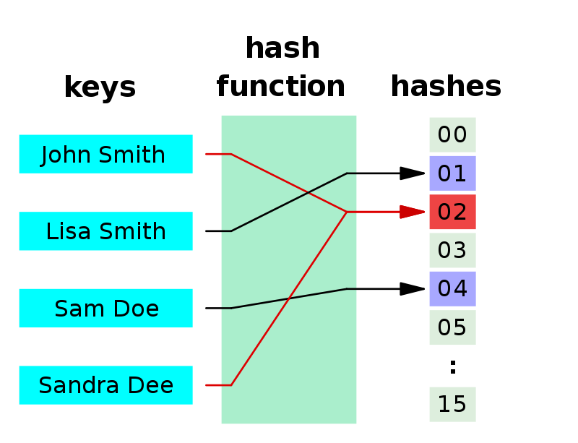
Hashing for Hash tables (dictionaries)
Hash tells you which RAM location to look in.
Much faster than iterating through a huge list or array.
This is why dictionaries are often quicker than arrays!
Any problems in diagram?

Slide 8
Cracking
In groups
  Lets say you were given some hash digests for 4-digit numbers to crack
  Discuss how you might go about doing that and write down your ideas / heuristics
How about normal text passwords?
  6-letter passwords
  Longer passwords
Now crack some hashes: https://github.com/LudlowCode/taster
2026 high score is 4 5 from Church Stretton Tenbury pupils

Slide 9
Recap
Hash functions are one way
Key → Value (digest)
3 major uses:
  Hash tables / dictionaries store data efficiently
  Cryptographic hash functions
    Password storage and checking
    Checking data hasn’t been corrupted
    Cryptocurrency mining (PoW)
Cracking hashes takes a lot of compute for brute force
  Heuristics help
  Dictionary attacks
  Social engineering

